Slide 1
Business Process Engineering
Week 09

Slide 2
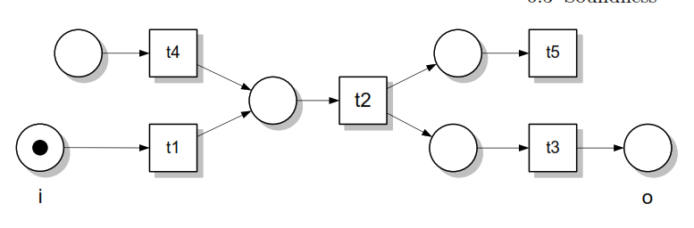
Structural Soundness
Structural errors.
Process models represented using process orchestration languages
Structural errors are represented uses Petri nets, in most cases, workﬂow nets.

Slide 3
Soundness assume that a process is structurally sound.
A process model is structurally sound if the criterion that a process model should fulfill. following
conditions hold:
There is exactly one initial node, which is only node without any incoming edges. (i)
There is exactly one final node, which is only node without any outgoing edges. (o)
Each node in the process model is on a path from the initial node to the final node. (i) to (o)

Slide 4
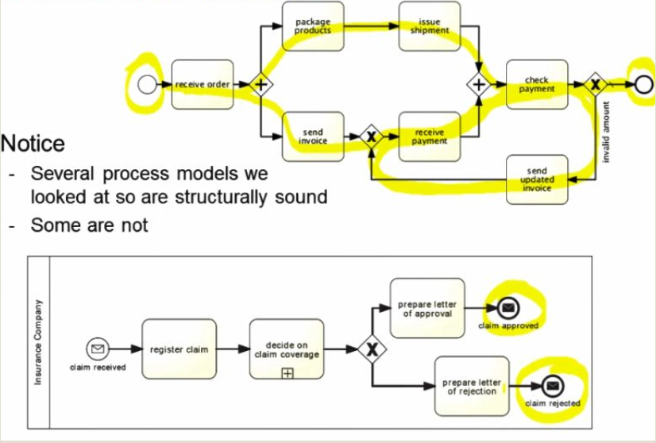

Slide 5
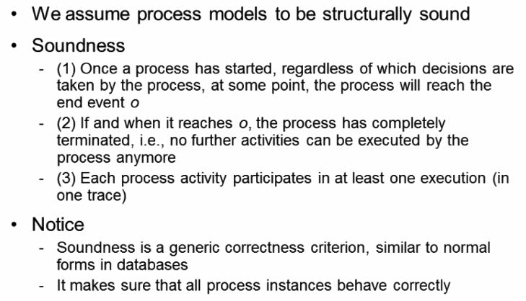
Soundness criterion

Slide 6
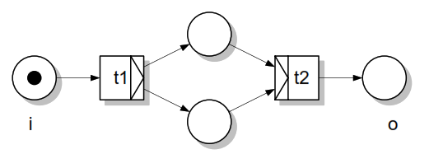
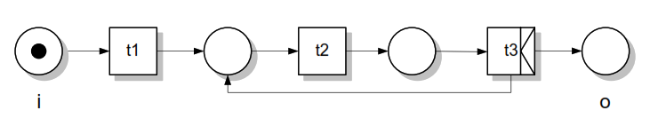
Deadlocks and Livelocks

Slide 7
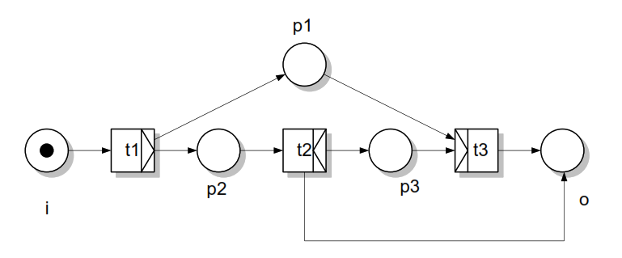

Slide 8
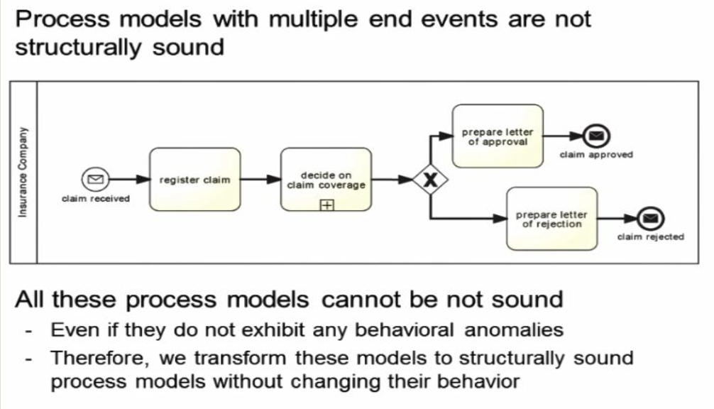

Slide 9
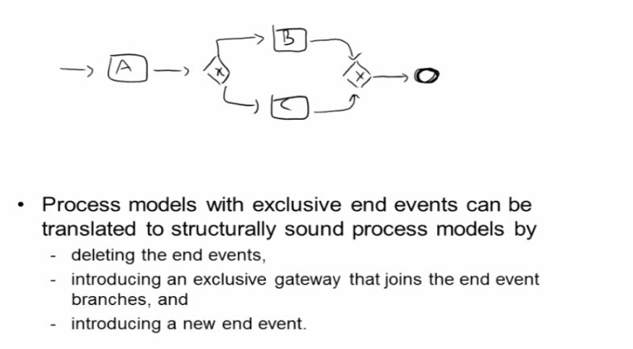
To start formal analysis
Now we transform the structurally unsound process into structurally sound process.

Slide 10
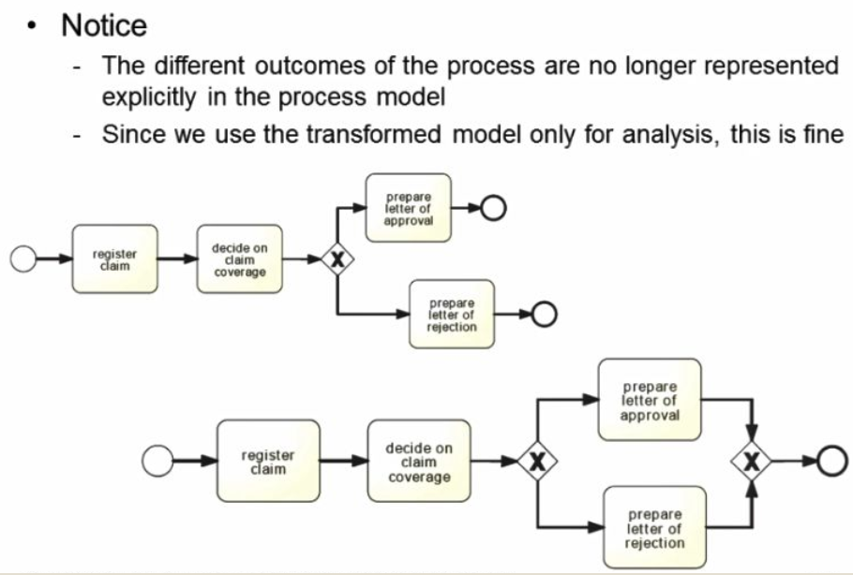

Slide 11
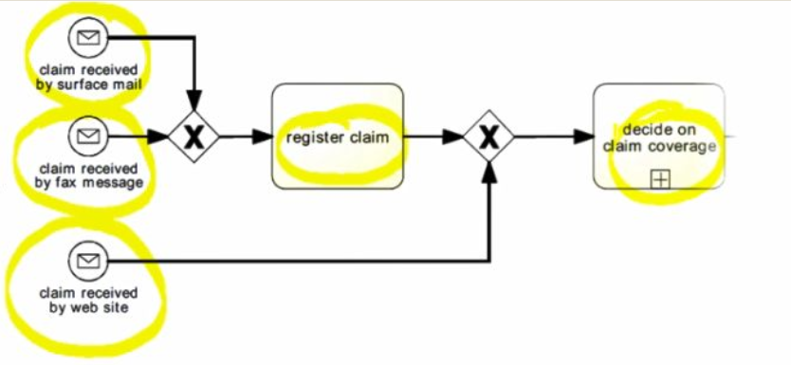

Slide 12
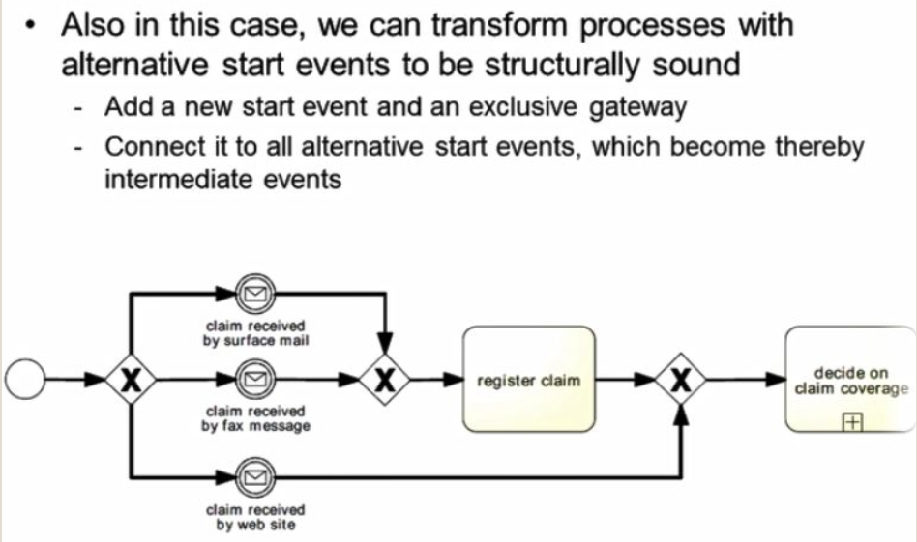

Slide 13
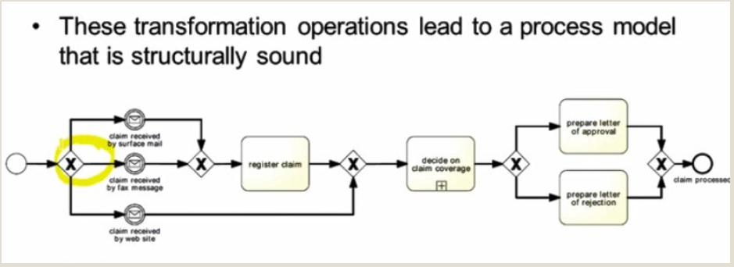

Slide 14
Relaxed Soundness
The idea of relaxed soundness is that for each transition there is a firing sequence that relaxed soundness allows business process models that expose deadlock behavior.
A process is relaxed sound if each task of the business process is part of a properly terminating sequence.

Slide 15
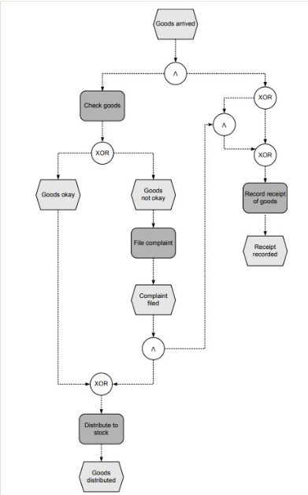

Slide 16
Weak Soundness
Weak soundness disallows deadlocks, but it allows certain parts of the process not to participate in any
process instance, A workflow system (P N, i) is weak sound if and only if the following holds:
For every state M reachable from state i there exists a firing sequence leading from M to o, i.e.,

Slide 17
Lazy Soundness
assume that the offers received from Suppliers 1 and 2 have led to the activation of the join.
Further assume that the offers from Suppliers 3 and 4 arrive only after the final event has been reached.
Then, receiving the offers for Suppliers 3 and 4 and paying them are lazy activities.

Slide 18
